Slide 1
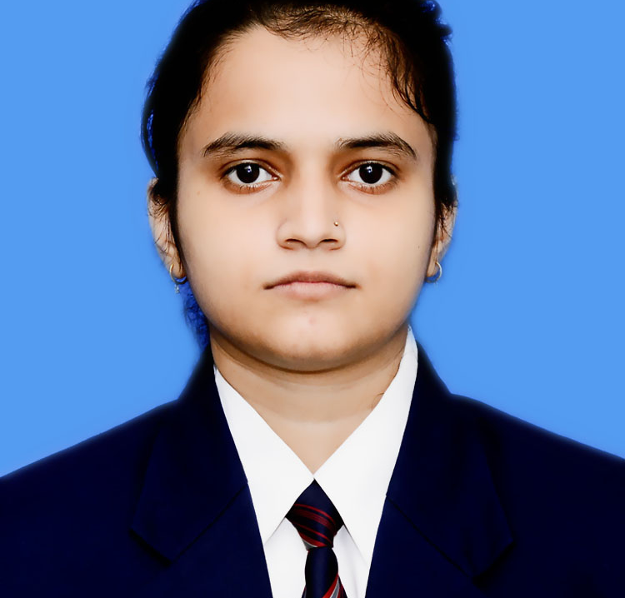



Aanchal Mishra
Analyst/Software Engineer
Master Of Computer Application(MCA) : 2020 - 2022
Skills
Java 8 /J2EE | Java Basics, OOPS, Generics, Collections, Arrays, Loops, Lambda Expressions
Spring core | IOC & Dependency Injection, Autowire
Spring REST | REST controllers, Implementation of GET, POST, PUT & DELETE, Bean Validation & Exception Handling, Controller & Repository layer
Spring Data JPA | Implement DAO layer using spring Data repositories
Spring Boot Microservices | Spring Boot Starters, annotations, Messaging Service using RabbitMq,Swagger API documents
Spring Cloud | Eureka, Spring Cloud API Gateway
Database | MongoDB
UI Tech | HTML 5 & CSS 3,JavaScript,Bootstrap,ReactJs
Tools | Git, Postman, IDE
Add On skills | Time management, Team Management
Mumbai
aanchal.mishra@capgemini.com
+91 8052668846
A4
Full Stack Developer
Hands on experience in creating microservices with Spring Boot, Spring Security, Spring Cloud API Gateway, Eureka server
Proficient in creating Single page Web Application in react
Experience in creating documentation with swagger and in unit testing using Junit, Mockito, in messaging service using RabbitMQ, in email service
Development experience in creating docker images and pushing to Docker Hub
Online Railway Reservation System
Completed end to end case study of Online Railway Reservation System along with JWT authentication, Swagger and payment implementation using Paytm gateway, UI with ReactJS used for user interface.
Banking Management System
Developed Banking Management System using Spring Boot, Postgresql and testing all api through postman
Check out my work on GitHub & Video Profile

